Slide 1


<Rauf O. Giwa>
<06/16/2022>

Slide 2

Outline
Executive Summary
Introduction
Methodology
Results
Conclusion
Appendix

Slide 3
Executive Summary
Data from public SpaceX API and SpaceX Wikipedia page.
Quantitative data on successful and failed landing mission.
Data exploration using SQL, visualization, folium maps, and dashboards.
Optimized Standardized data and used GridSearchCV to find best parameters for machine learning prediction models. Visualize accuracy score of all models.
Four models Logistic Regression, Support Vector Machine, Decision Tree Classifier, and K Nearest Neighbors. accuracy > 83.33%.
Summary of methodologies
Summary of all results

Slide 4
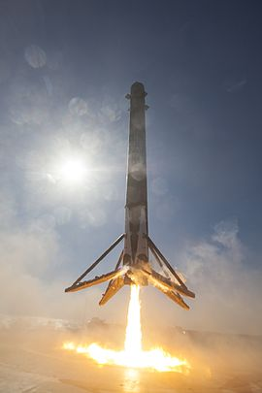
Introduction
Project background and context
The commercial space age is here, Virgin Galactic. Rocket Lab, Blue Origin.
most successful is SpaceX
Price per launch : $62m compared to $165m.
Strategy: can reuse the first stage
Problem
Allon Musk, SpaceY CEO, wish to compete with SpaceX
Use machine learning to predict fails and successful landing of falcon 9 launches from the Wikipedia page

Slide 5

Section 1

Slide 6
Methodology
Executive Summary
Data collection methodology:
Data collected from SpaceX public API and SpaceX Wikipedia page
Perform data wrangling
Quantify landings as successful of failed
Perform exploratory data analysis (EDA) using visualization and SQL
Perform interactive visual analytics using Folium and Plotly Dash
Perform predictive analysis using classification models
ML models were optimized to generate best prediction.

Slide 7
Data Collection
Collecting data involved use of many of APIs. E.g. http requests from SpaceX public API and scraping data from a tables in SpaceX’s Wikipedia entry.
SpaceX data: FlightNumber, Date, BoosterVersion, PayloadMass, Orbit, LaunchSite, Outcome, Flights, GridFins,
Reused, Legs, LandingPad, Block, ReusedCount, Serial, Longitude, Latitude
Wikipedia data: Flight No., Launch site, Payload, PayloadMass, Orbit, Customer, Launch outcome, Version Booster, Booster landing, Date, Time

Slide 8
Data Collection – SpaceX API
GitHub URL:
github.com/raufgiwa-scikits/IBM-Data-Science-Professional-Certificate/blob/main/Applied_Data_Science_Capstone/Week1-spacex-data-collection-api.ipynb
Request (SpaceX APIs)
Make JSON file with list of data columns
Make dictionary of data
Normalize JSON to Dataframe
Cast dictionary to DataFrame
Filter out Falcon 9 data
Replace missing value with mean

Slide 9
Data Collection - Scraping
Add the GitHub URL : github.com/raufgiwa-scikits/IBM-Data-Science-Professional-Certificate/blob/main/Applied_Data_Science_Capstone/Week1-DataCollection%20with%20webscraping.ipynb
Request (Falcon 9 launches from Wikipedia)
Make a BeautifulSoup using html.parser
Fill dictionary with processed data from table rows
Create a dictionary and fill columns
Cast dictionary to DataFrame

Slide 10
Data Wrangling
Describe how data were processed
Create label to quantify landing outcomes True(success)=1 and False (fail)=0
Outcome has two data, mission outcome and landing location
If true is in the data->1, if false is in the data->0
A class label which reads off mission outcome and returns 1 or zero
Create dataframes for failed and successful missions based on orbit
Add the GitHub URL : github.com/raufgiwa-scikits/IBM-Data-Science-Professional-Certificate/blob/main/Applied_Data_Science_Capstone/Week1-Data%20wrangling.ipynb

Slide 11
EDA with Data Visualization
Exploratory Data Analysis performed on variables Flight Number, Payload Mass, Launch Site, Orbit, Class and Year.
Plots Used:
Scatter: Flight Number vs. Payload Mass, Flight Number vs. Launch Site, Payload Mass vs. Launch Site, Flight Number vs. Orbit, Payload vs Orbit.
Bar chart: Orbit vs. Success Rate.
Line chart: Success Yearly Trend
Scatter plots, line charts, and bar plots were used to visually observe relationships between variables to see if an relationship exists.
GitHub url: github.com/raufgiwa-scikits/IBM-Data-Science-Professional-Certificate/blob/main/Applied_Data_Science_Capstone/WEEK2-eda-dataviz.ipynb

Slide 12
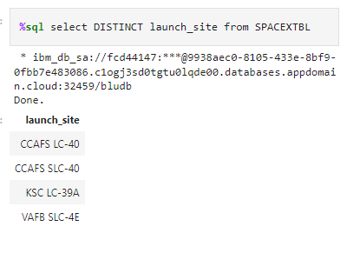
EDA with SQL
Data set uploaded into IBM DB2 Database.
SQL performed using Python-SQL commands.
Queries gave deeper insight into the dataset.
Queries gave information about mission outcomes, dates , launch sites, pay load masses, and booster versions, and landing outcomes
GitHub url: https://github.com/raufgiwa-scikits/IBM-Data-Science-Professional-Certificate/blob/main/Applied_Data_Science_Capstone/Week2-eda-sql-coursera_sqllite.ipynb

Slide 13
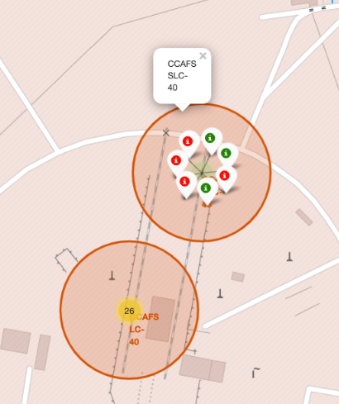
Build an Interactive Map with Folium
Folium maps with markers representing location of launch site. Green/red for successful/failed missions. Circles are area of launch site Launch Sites, successful and unsuccessful landings, and a proximity example to key locations: Railway, Highway, Coast, and City.
GitHub url: https://github.com/raufgiwa-scikits/IBM-Data-Science-Professional-Certificate/blob/main/Applied_Data_Science_Capstone/Week3_%20Interactive_Visua_Analytics_and_Dashboard.ipynb

Slide 14
Build a Dashboard with Plotly Dash
Dashboard includes pie chart and scatter plot.
Pie chart can select all launch and show individual launch site success rates or for each launch sites and show success and fail rate.
Scatter plot takes two inputs for All sites or individual site and payload mass on a slider between 0 and 10000 kg.
The scatter plot can help us see how success varies across launch sites, payload mass, and
booster version category.
Add the GitHub URL: https://github.com/raufgiwa-scikits/IBM-Data-Science-Professional-Certificate/blob/main/Applied_Data_Science_Capstone/spacex_dash_app.py

Slide 15
Predictive Analysis (Classification)
Split label column ‘class’ from dataset
Transform and fit data and create a model
Split data into train and test set
Check accuracy using scores
Use GridSearchCV to find best model parameters (LogReg, SVM, DT and KNN)
GridSearchCV (cv=10) to find parameters
Create confusion for all model
Bar plot to compare best parameters of different models
GitHub URL: https://github.com/raufgiwa-scikits/IBM-Data-Science-Professional-Certificate/blob/main/Applied_Data_Science_Capstone/Week4%20Machine%20Learning%20Prediction.ipynb

Slide 16
Results
Exploratory data analysis results
Interactive analytics demo in screenshots
Predictive analysis results

Slide 17

Section 2

Slide 18
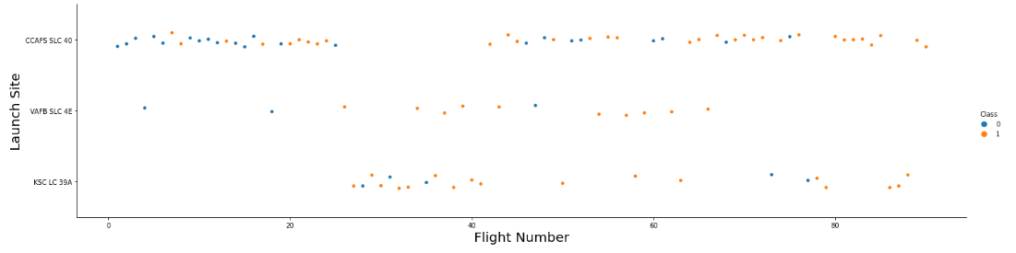
Flight Number vs. Launch Site
Blue indicates successful launch; Orange indicates unsuccessful launch.
Graphic suggests an increased success rate over time. A plausible reason is an improvement in flight conditions . CCAFS appears to be the main launch site as it has the most volume.

Slide 19
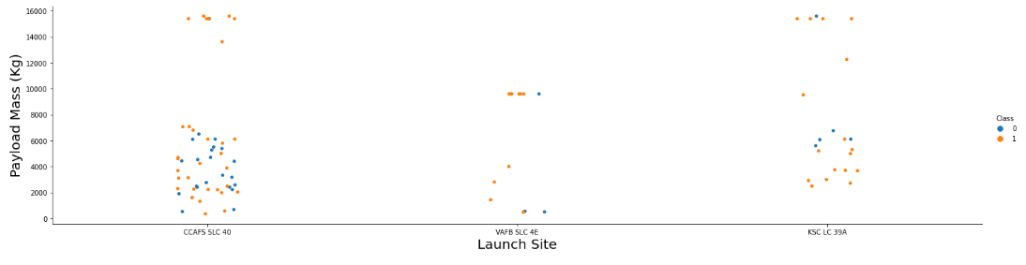
Payload vs. Launch Site
Blue indicates successful launch; Orange indicates unsuccessful launch.
Payload mass appears to fall mostly between 0-6000 kg. Different launch sites also seem to use different payload mass

Slide 20
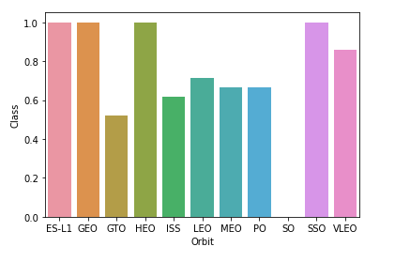
Success Rate vs. Orbit Type
Success Rate Scale with 0 as fail and 1 as success
ES-L1 (1), GEO (1), HEO (1) have 100% success rate (sample sizes in parenthesis) SSO (5) has 100% success rate
VLEO (14) has decent success rate and attempts
SO (1) has 0% success rate
GTO (27) has the around 50% success rate but largest sample

Slide 21
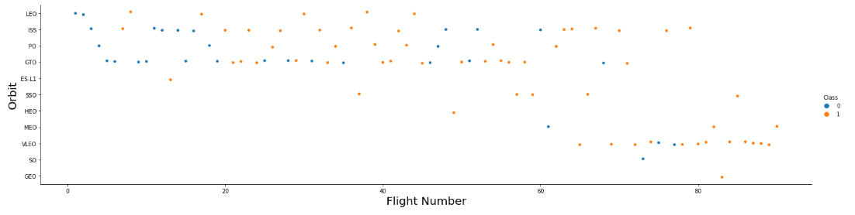
Flight Number vs. Orbit Type
Blue indicates successful launch; Orange indicates unsuccessful launch.
Launch Orbit preferences changed over Flight Number. Launch Outcome seems to correlate with this preference.
SpaceX started with LEO orbits which saw moderate success LEO and returned to VLEO in recent launches SpaceX appears to perform better in lower orbits or Sun-synchronous orbits

Slide 22
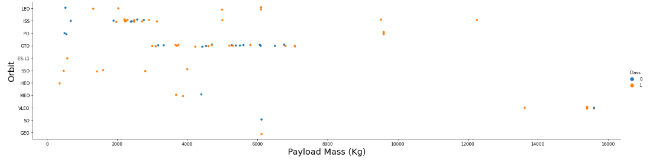
Payload vs. Orbit Type
Blue indicates successful launch; Orange indicates unsuccessful launch.
Payload mass correlates with orbit
Relatively low payload mass were sent into LEO and SSO

Slide 23
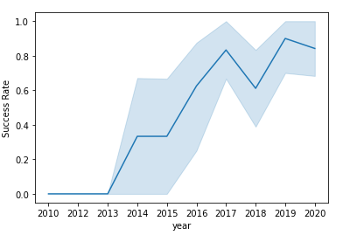
Launch Success Yearly Trend
Line : success rate:
light blue : 95% confidence
A generally increase in success over time since 2013 with a slight dip in 2018
Success since 2016 is around 0.8

Slide 24
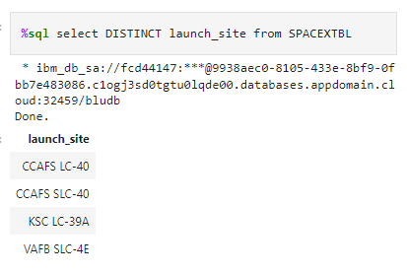
All Launch Site Names
Query unique launch site names from database.
CCAFS LC-40 and CCAFS SLC-40 likely all represent the same site.

Slide 25
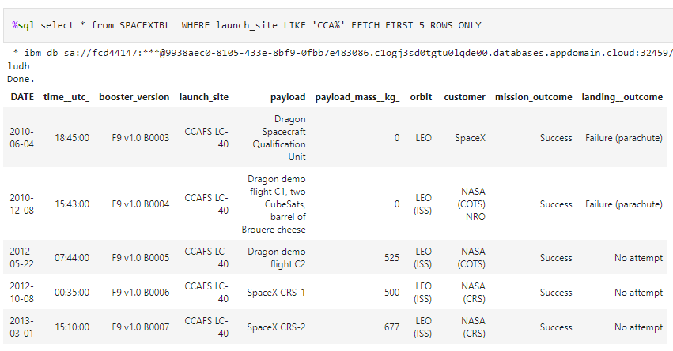
Launch Site Names Begin with 'CCA'
First 5 records where launch sites begin with `CCA`

Slide 26
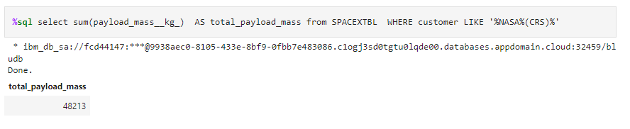
Total Payload Mass
This query sums the total payload mass in kg where NASA was the customer.
CRS stands for Commercial Resupply Services which indicates that these payloads were sent to the International Space Station (ISS).

Slide 27
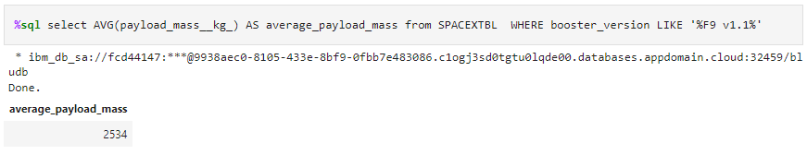
Average Payload Mass by F9 v1.1
This query calculates average payload mass or launches with booster version F9 v1.1
Average payload mass of F9 1.1 is on the lowed end of payload mass range

Slide 28
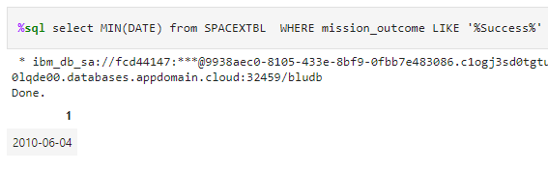
First Successful Ground Landing Date
This query returns the first successful ground pad landing date.
First ground pad landing was in 2010.

Slide 29
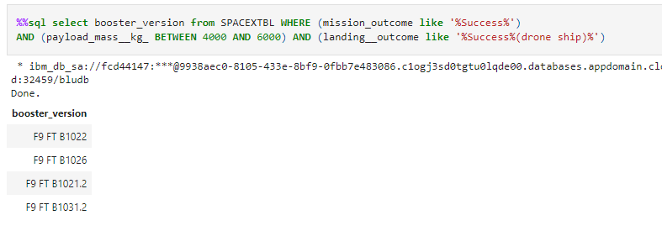
Successful Drone Ship Landing with Payload between 4000 and 6000
This query returns booster versions that had successful drone ship landings and a payload mass between 4000 and 6000 kg.

Slide 30
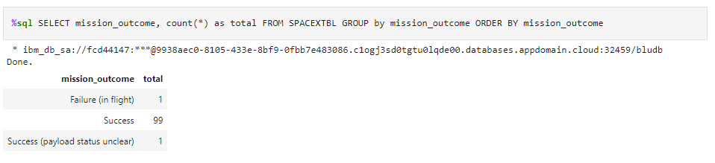
Total Number of Successful and Failure Mission Outcomes
Query return the total number of successful and failure mission outcomes
Most SpaceX missions were successful.

Slide 31
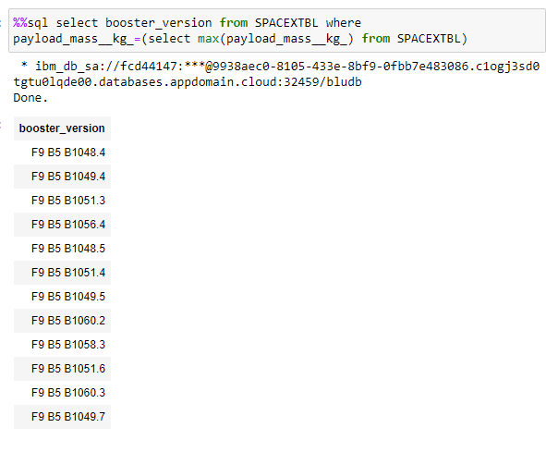
Boosters Carried Maximum Payload
This query lists the names of the booster which have carried the maximum payload mass
Boosters used for max payload are in the same family of boosters

Slide 32
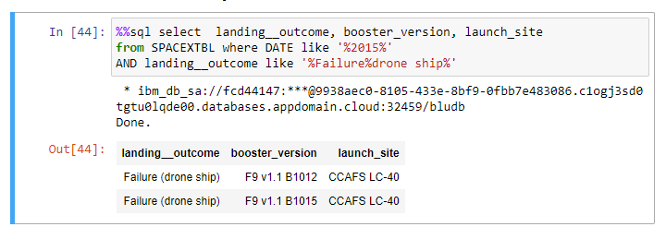
2015 Launch Records
This query returns the Month, Landing Outcome, Booster Version, Payload Mass (kg), and Launch site of the failed landing outcomes in drone ship, their booster versions, and launch site names for in year 2015

Slide 33
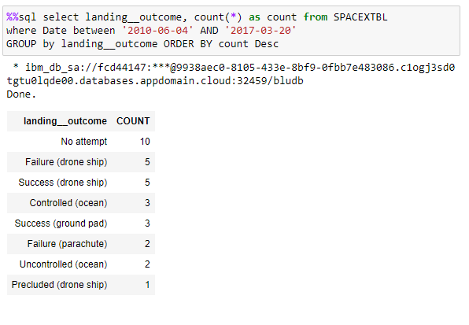
Rank Landing Outcomes Between 2010-06-04 and 2017-03-20
This query ranks the count of landing outcomes (such as Failure (drone ship) or Success (ground pad)) between the date 2010-06-04 and 2017-03-20, in descending order
There are two types of successful landing outcomes: drone ship and ground pad landings.
There were 8/7 successful/failure landings in total during this time period

Slide 34

Section 3

Slide 35
<Folium Map Screenshot 1>
Replace <Folium map screenshot 1> title with an appropriate title
Explore the generated folium map and make a proper screenshot to include all launch sites’ location markers on a global map
Explain the important elements and findings on the screenshot

Slide 36
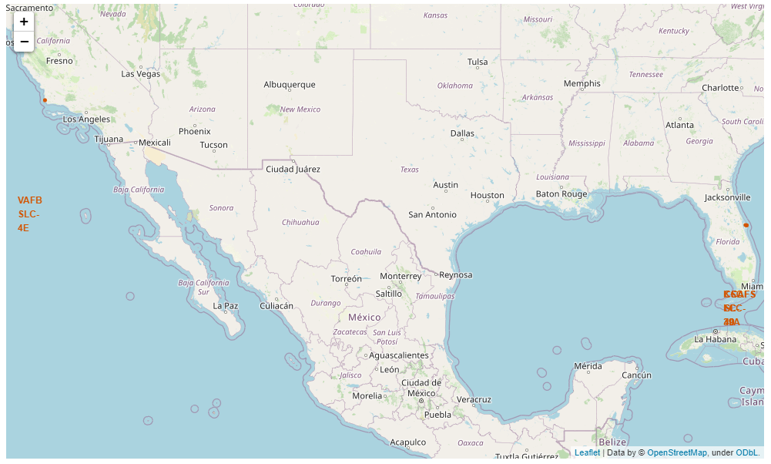
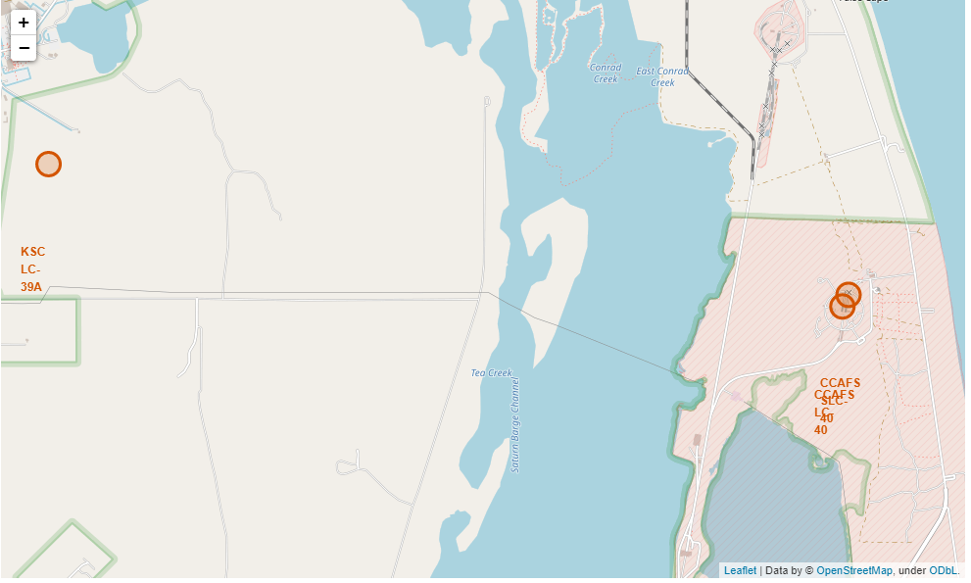
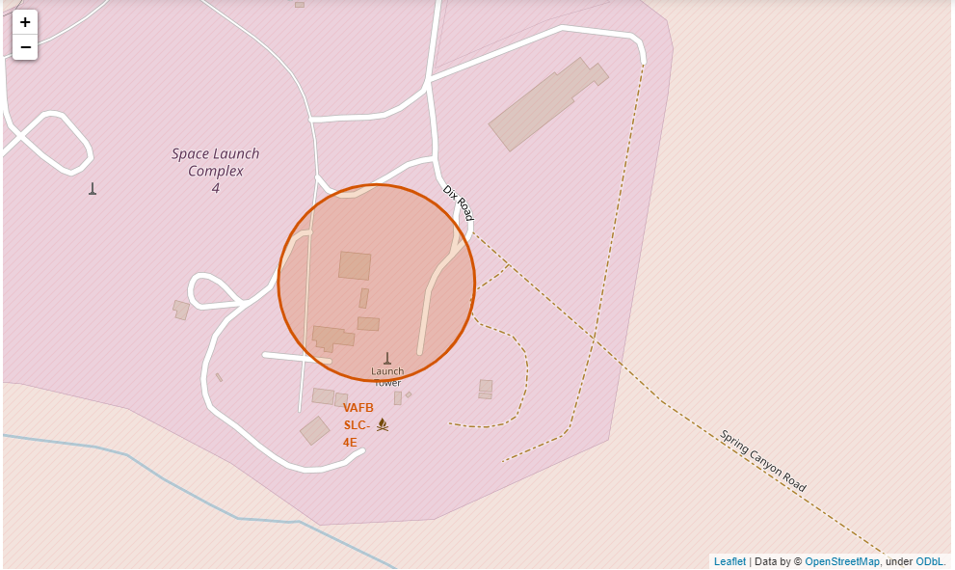
Launch site location
Folium map of launch site locations:

Slide 37
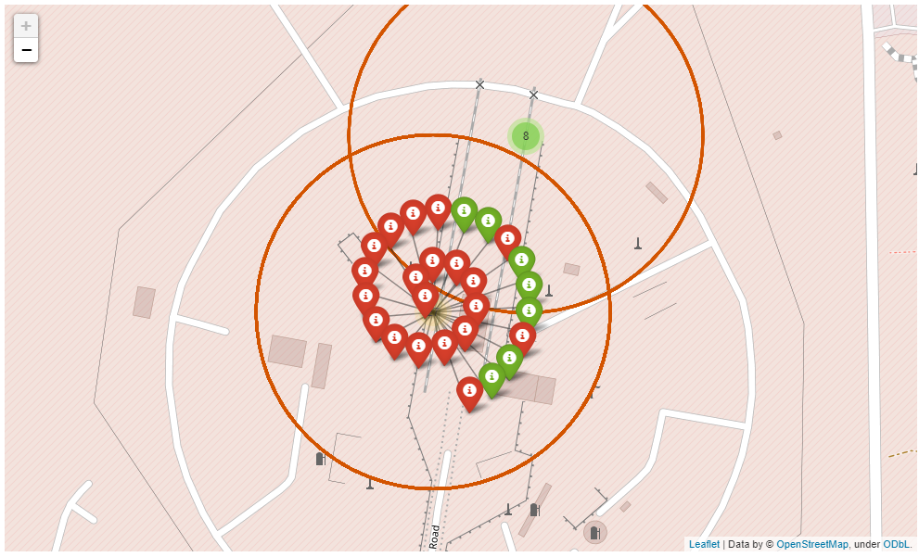
<Folium Map Screenshot 3>
Interactive clusters on Folium maps to display each successful landing (green icon) and failed landing (red icon).
In this example VAFB SLC-4E shows 4 successful landings and 6 failed landings.

Slide 38

Section 4

Slide 39
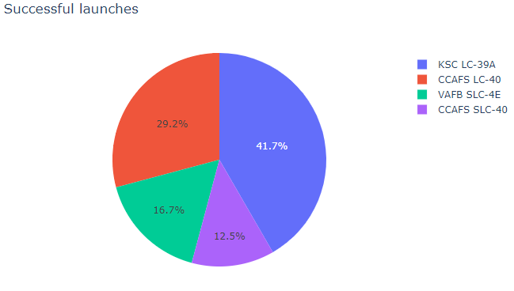
Launches with successful outcomes
Diatribution of success rate across launch sites

Slide 40
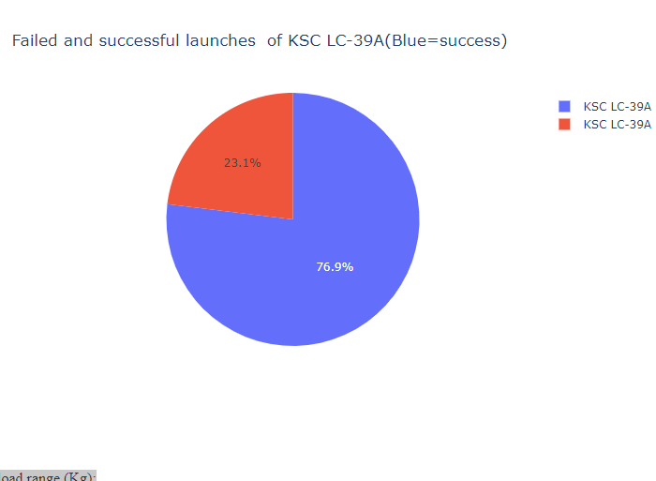
Highest Success Rate Launch Site
Piechart for the launch site KSC LC-39A with highest launch success ratio
KSC LC-39A has the highest success rate with 10 successful landings and 3 failed landings.

Slide 41
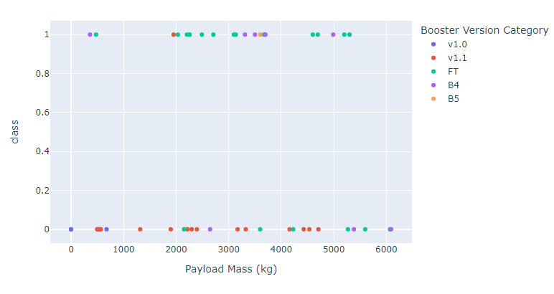
Payload Mass vs. Success vs. Booster Version Category
Dashboard has a Payload range selector set from 0-10000. Class indicates 1 for successful landing and 0 for failure.
Scatter plot shows booster version category and number of launches in point size.

Slide 42

Section 5

Slide 43
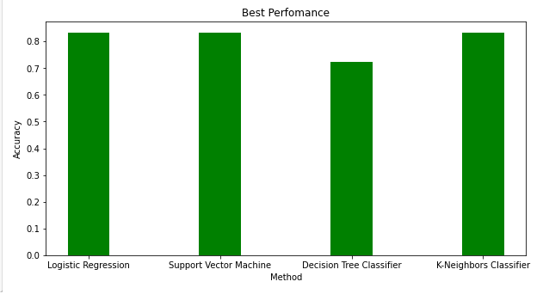
Classification Accuracy
LR,SVM and KNN had accuracy of about 83%.
While DTC had an accuracy of 70%

Slide 44
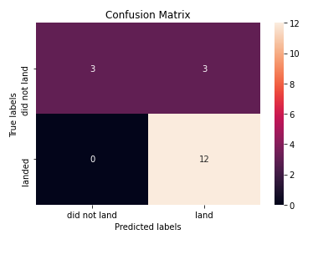
Confusion Matrix
Confusion matrix for KNN classifier
reports accuracy of KNN

Slide 45
Conclusions
Developed a machine learning model for Space Y based on data from SpaceX
To find a model to predict best parameters to give successful landings. Stage 1 will successfully land to save ~$100 million USD
Used data from a public SpaceX API and web scraping SpaceX Wikipedia page
Data labels and stored data into a DB2 SQL database
Adashboard for visualization
machine learning model with an accuracy over 80%

Slide 46


